Slide 1


Zero to Hipster with the M.I.K.E. Stack
Jen Looper and Charlie Key

Slide 2


Jen Looper
Developer Advocate, Telerik
@jenlooper

Slide 3

Charlie Key
Co-Founder, Modulus
@Zwigby

Slide 4
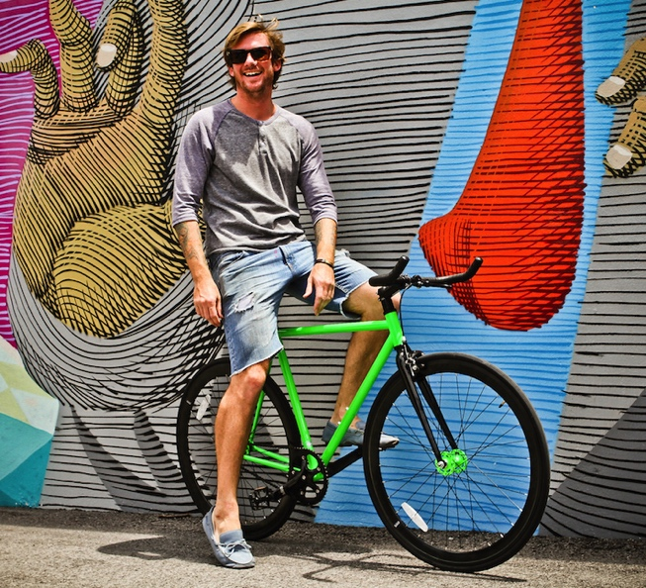
Signs of hipsterism
Fixed-Gear Bicycles

Slide 5
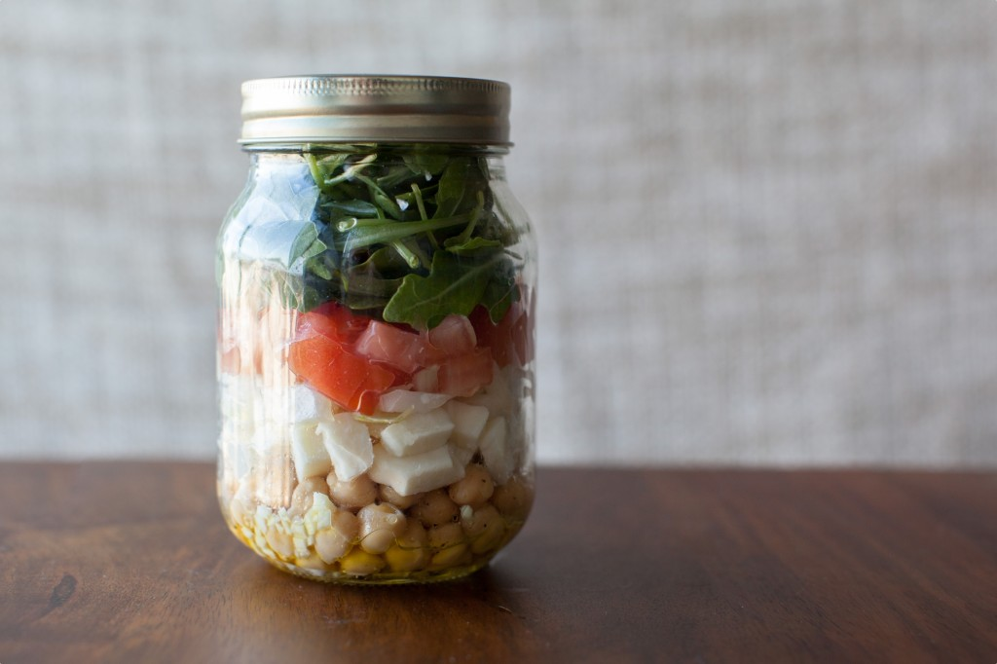
Signs of hipsterism
Mason Jar Lunches

Slide 6
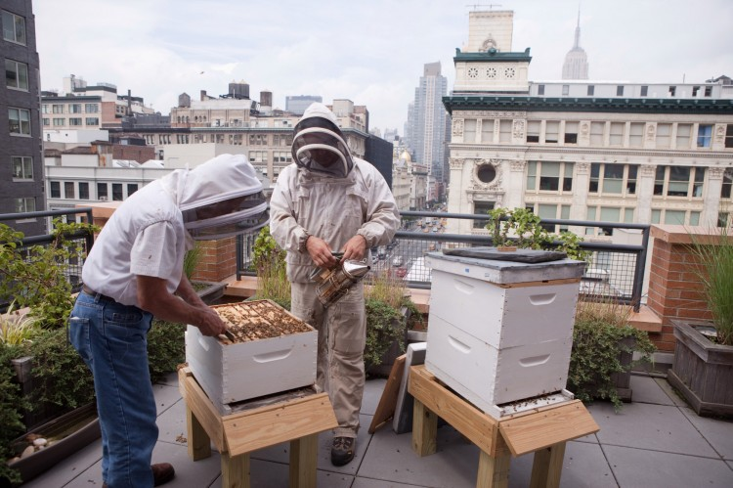
Signs of hipsterism
Urban Beekeeping

Slide 7
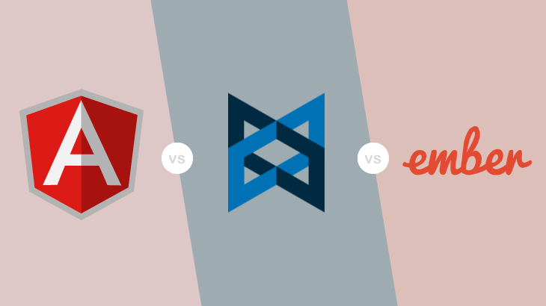
Signs of hipsterism
Using a Cool-Sounding JavaScript-Based Framework

Slide 8
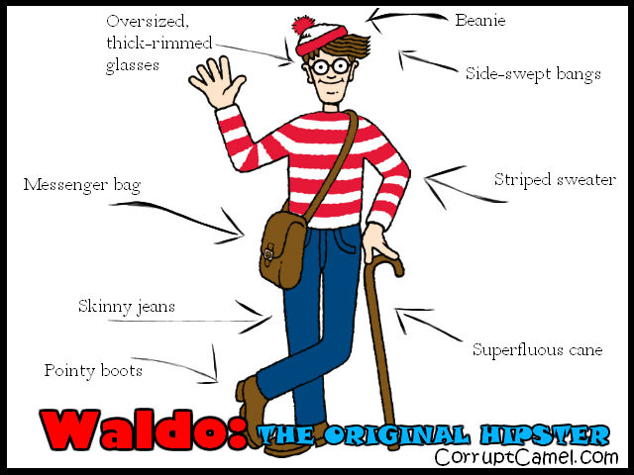
I’m totally a hipster.

Slide 9
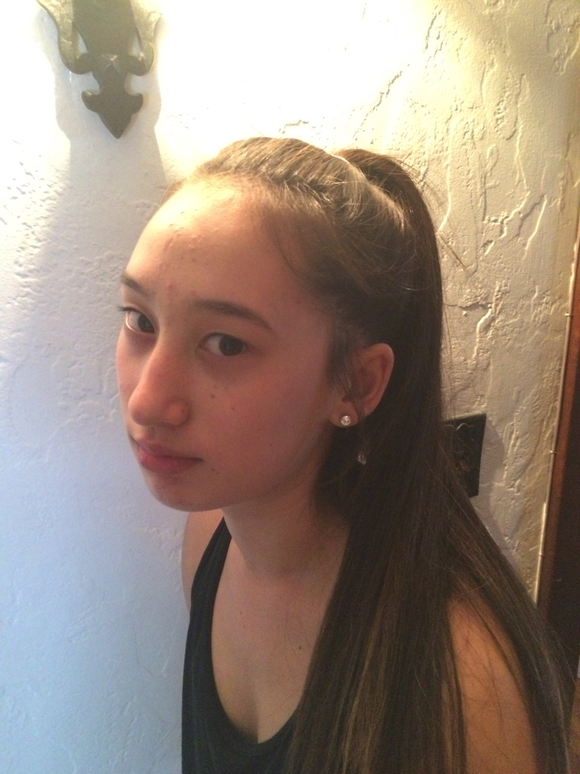
Mom, srsly!”
“If you call yourself a hipster, you’re so not one.”

Slide 10
You know you’re a hipster when…
You create your own darn web stack*
Presenting…the M.I.K.E. Stack
*with thanks also to Carl Bergenhem** and Burke Holland
**Carl looks kind of like Mike or vice versa

Slide 11



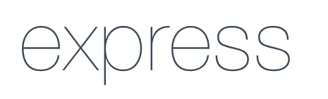
Meet M.I.K.E. for your SPA!
M
I
K
E
MongoDB - Database
}
Io.js - Backend Server
Kendo UI – Presentation & SPA routing
Express.js - Web Server & API

Slide 12
Meet M.I.K.E.
M
MongoDB – a noSQL database
Mongo – scalable, for ‘humongous’ amounts of data
Not a relational database
Uses JSON-based querying language
Flexible data model
SQL: select * from tblInventory
Mongo: db.inventory.find({})

Slide 13
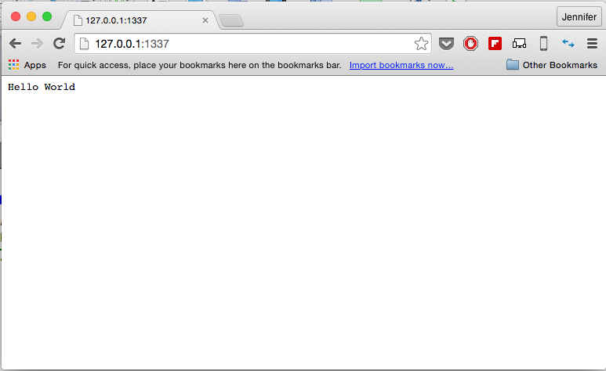
Meet M.I.K.E.
I
Io.js– (a fork of Node, we’re just going to use Node)
Io.js is hipper than Node but I won’t tell if you use Node
Node = server-side JS
//this goes in a file called example.js
var http = require('http');
http.createServer(function (req, res) {
res.writeHead(200, {'Content-Type': 'text/plain'});
res.end('Hello World\n');
}).listen(1337, '127.0.0.1');
console.log('Server running at http://127.0.0.1:1337/');
//execute it from the command line
% node example.js
Server running at http://127.0.0.1:1337/

Slide 14
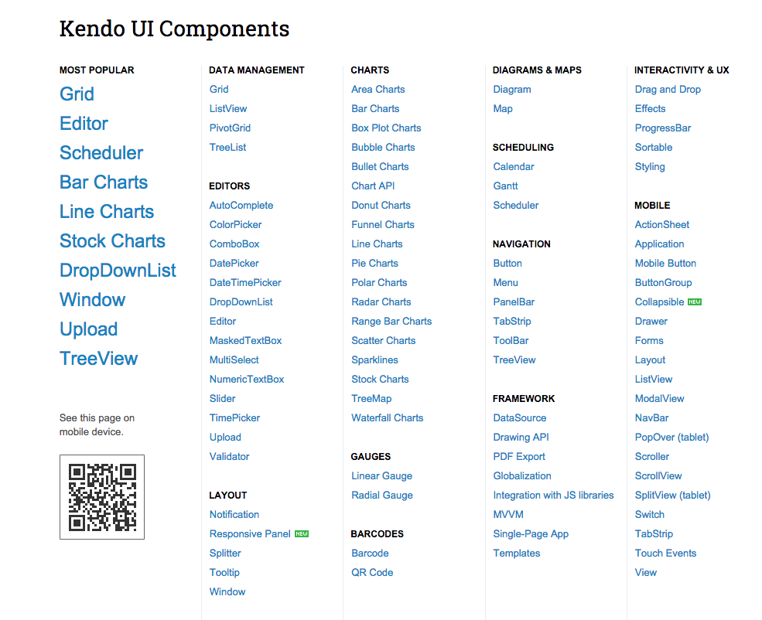
Meet M.I.K.E.
K
Kendo UI – Presentation layer
jQuery-based widgets to help you make your frontend look stylin’
Leverages HTML5 and JavaScript
Because rolling your own charts and grids = :’-(
Using Kendo routing to create SPA (no page refresh)

Slide 15
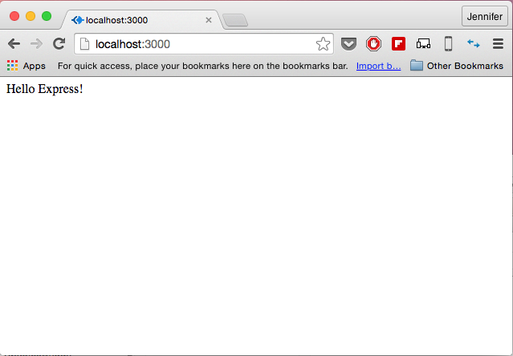
Meet M.I.K.E.
E
Express.js – your webserver
Because Node + Express = <3
Facilitates creating API
4. node test
1. add package.json to folder
& declare express as dependency
{
"name": "Mike",
"version": "0.0.0",
"private": true,
"scripts": {
"start": "node ./bin/www"
},
"description": "Mike",
"author": {
"name": "Looper",
"email": ""
},
"dependencies": {
"express": "~4.9.0"
}
}
2. npm install to add express to the folder
3. Create test.js in folder:
var express = require('express')
var app = express()
app.get('/', function (req, res) {
res.send('Hello Express!')
})
var server = app.listen(3000, function () {
var host = server.address().address
var port = server.address().port
console.log('Example app listening at http://%s:%s', host, port)
})

Slide 16
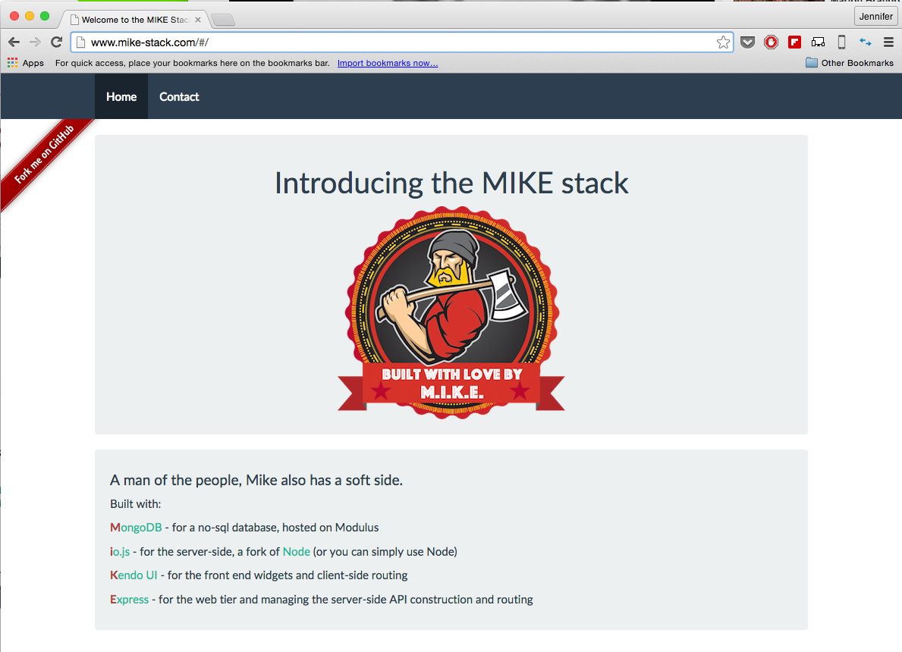
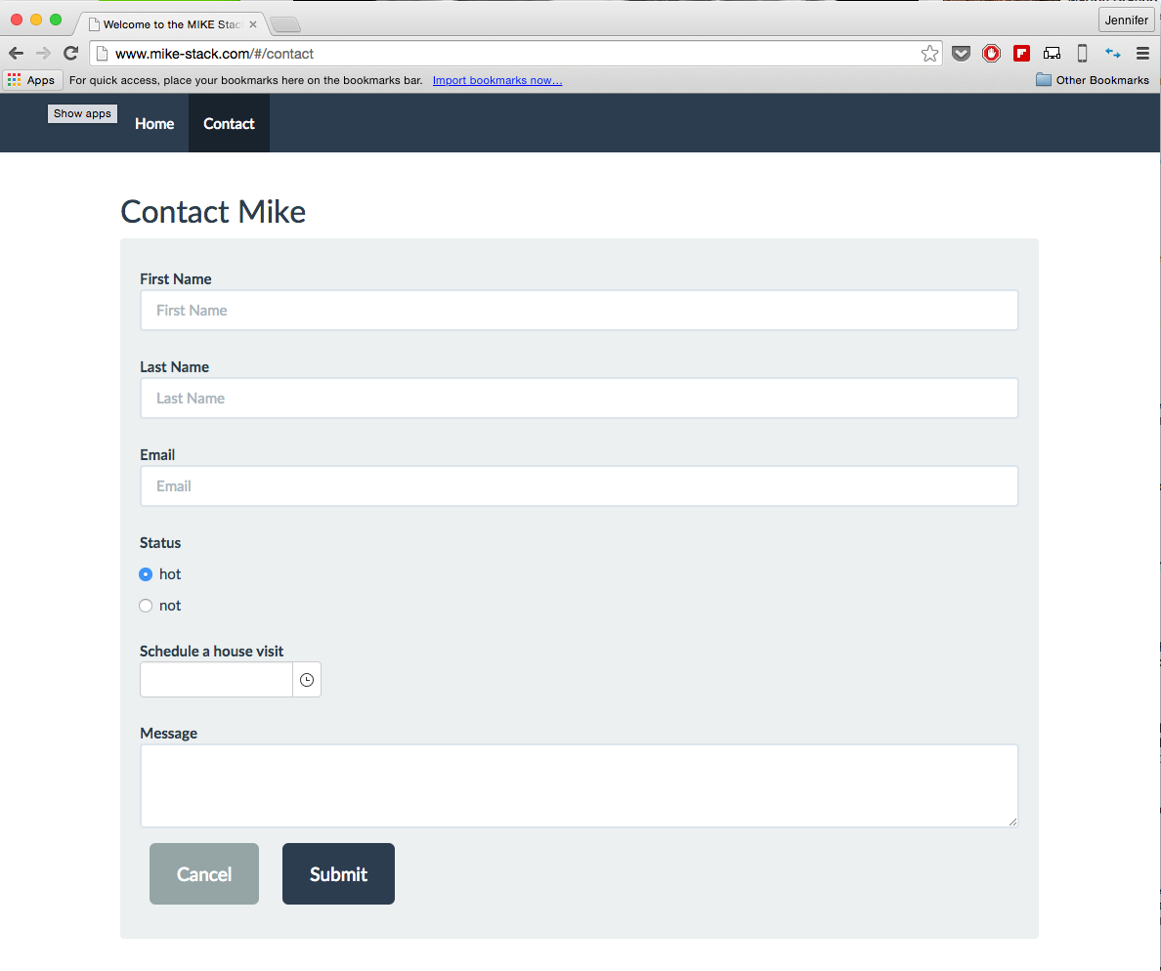
http://www.mike-stack.com
https://github.com/jlooper/mike

Slide 17
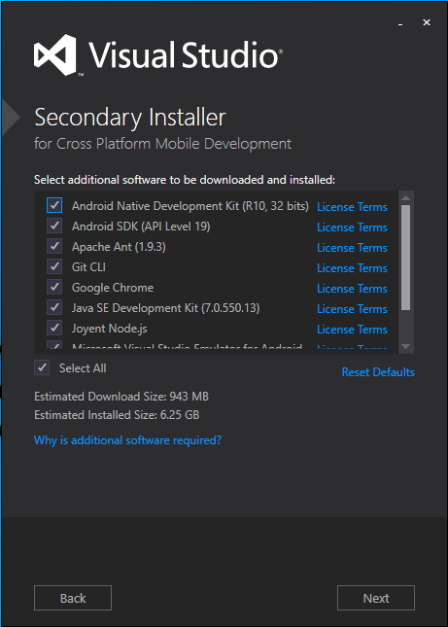
Let’s get started!
Let’s build a SPA-style web site using the M.I.K.E. stack because we can
I’m using Visual Studio 2013 on Windows 8.1
with Node installed

Slide 18
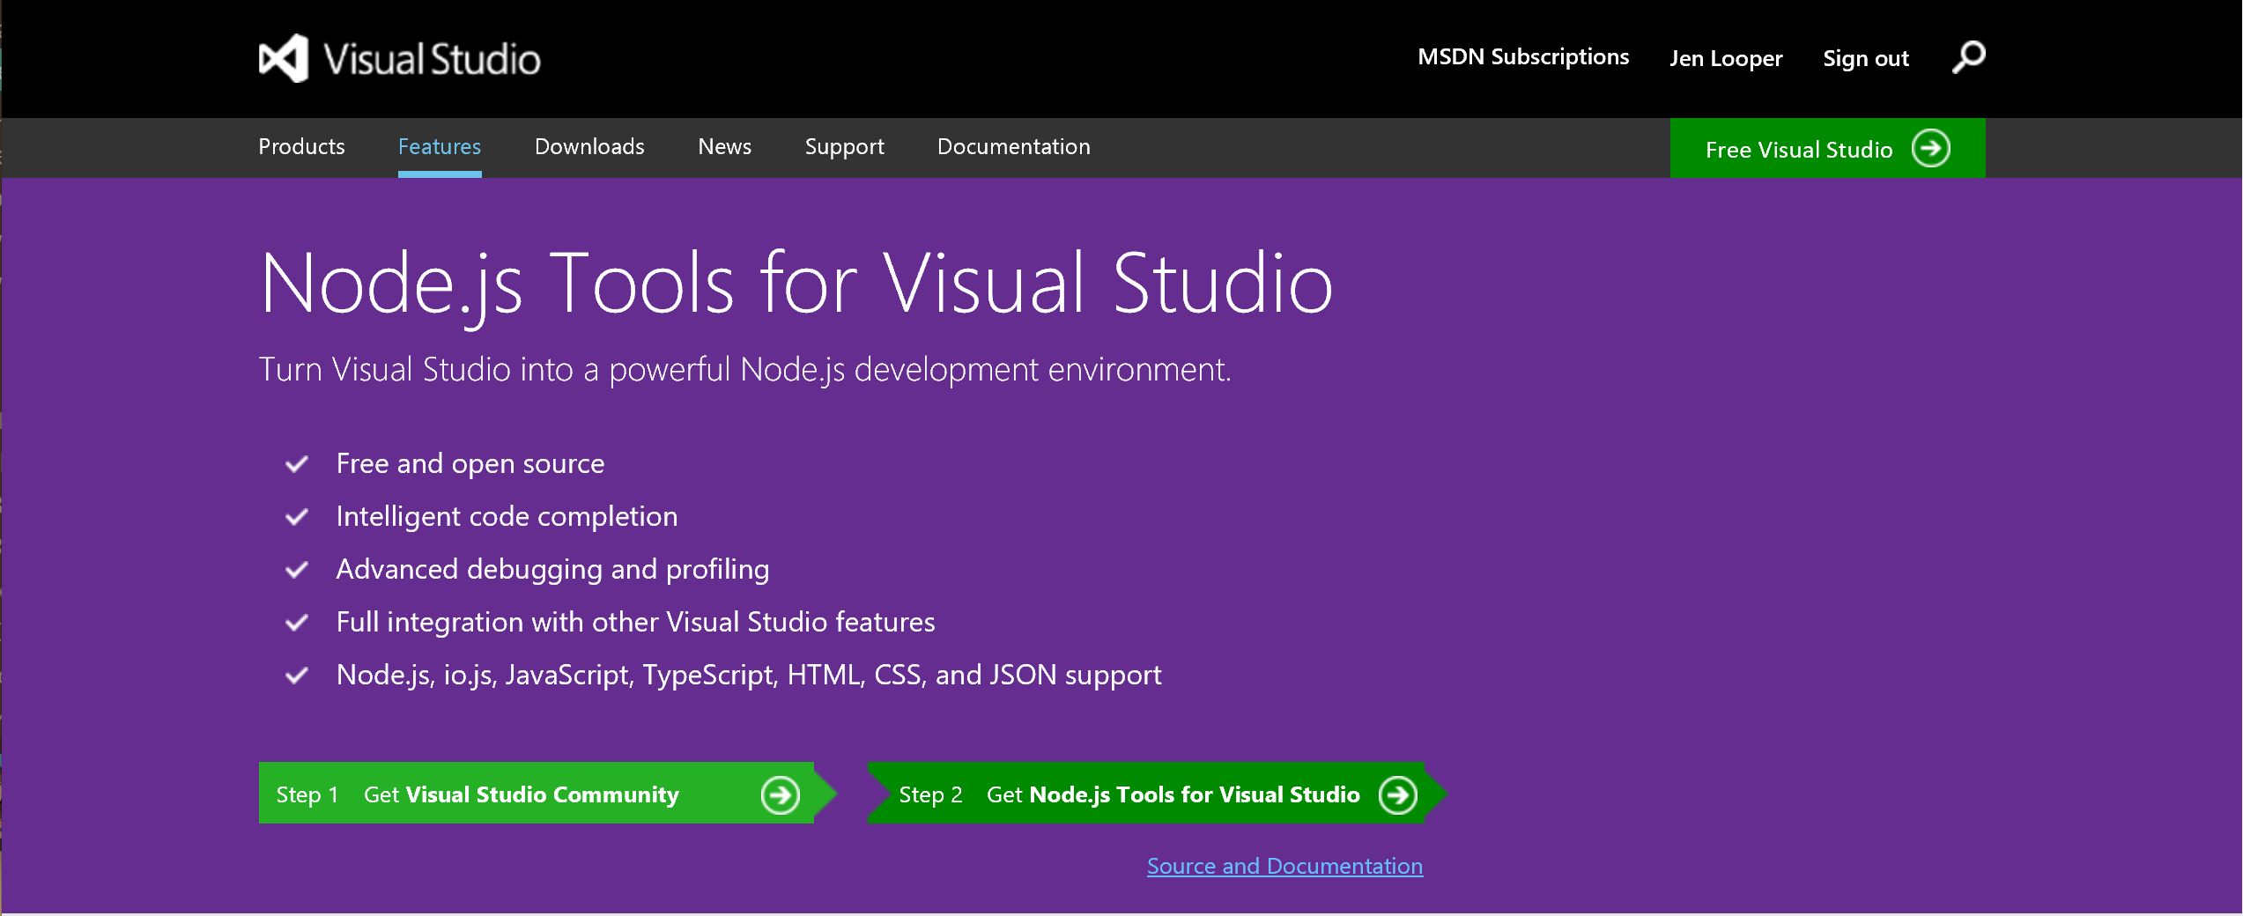
Install NodeJS Tools for Visual Studio

Slide 19
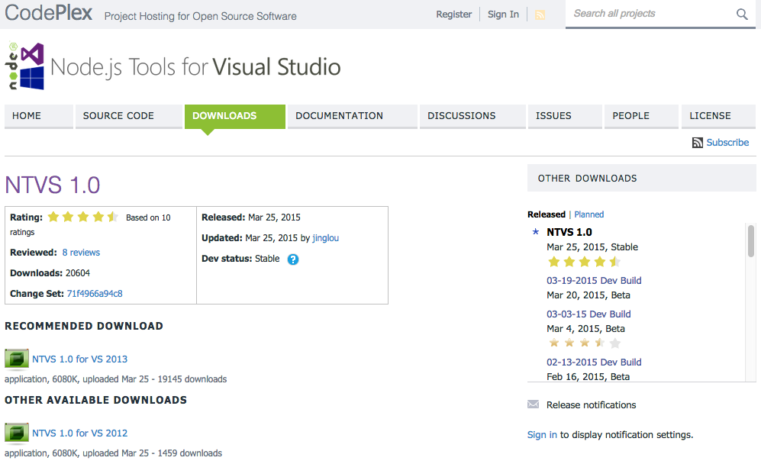
NodeJS Tools available from Codeplex

Slide 20
Today’s tasks:
Scaffold an Express 4 app in VS and clean it up for our purposes
Set up an Express Route
Add Kendo UI and Bootstrap for pretteh + SPA behavior
All about that database!
Craft your API

Slide 21
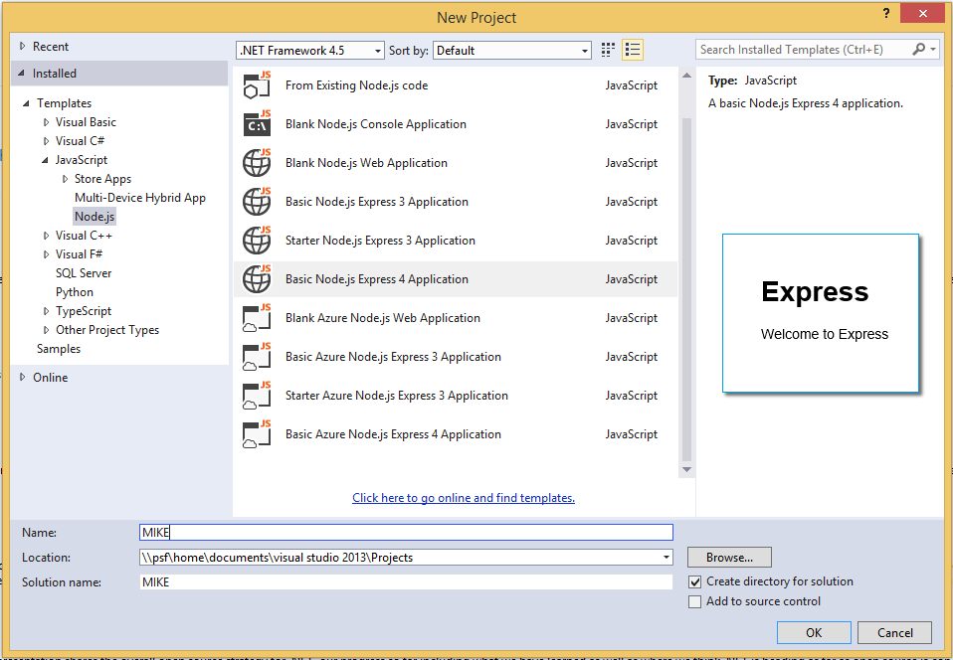
Create a new Express 4 Project

Slide 22
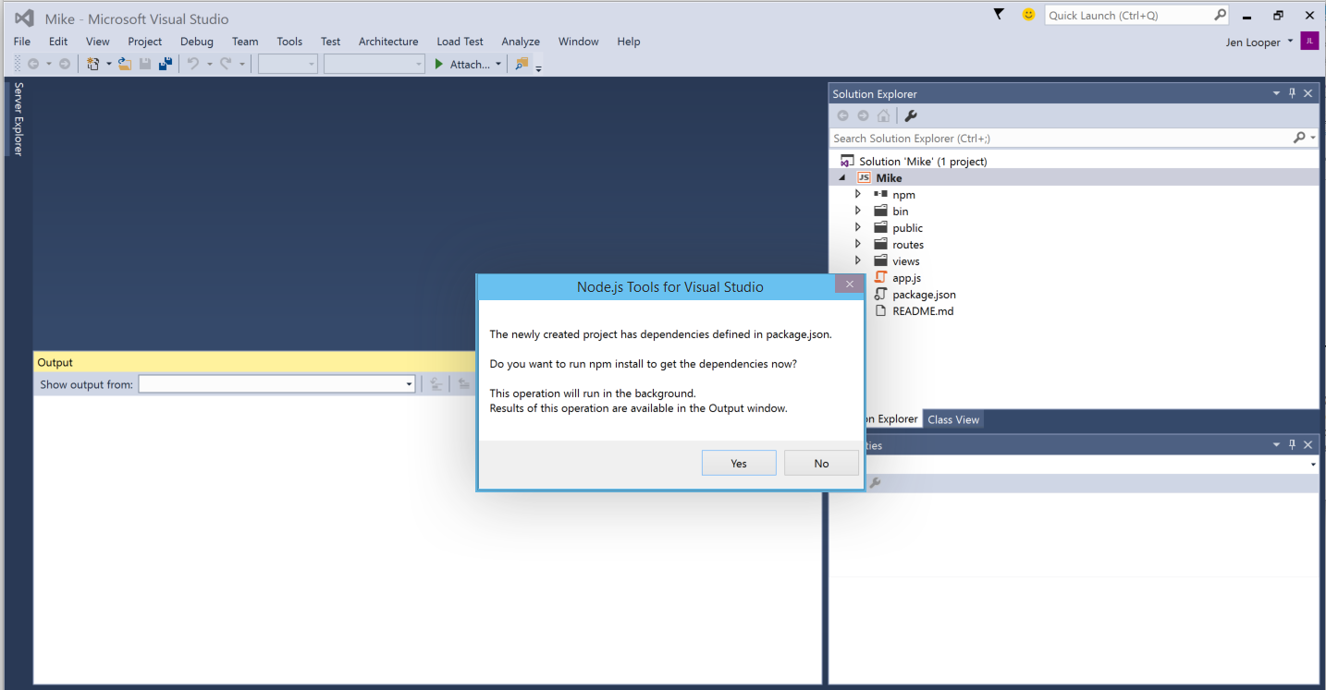
VS will install dependencies for you

Slide 23
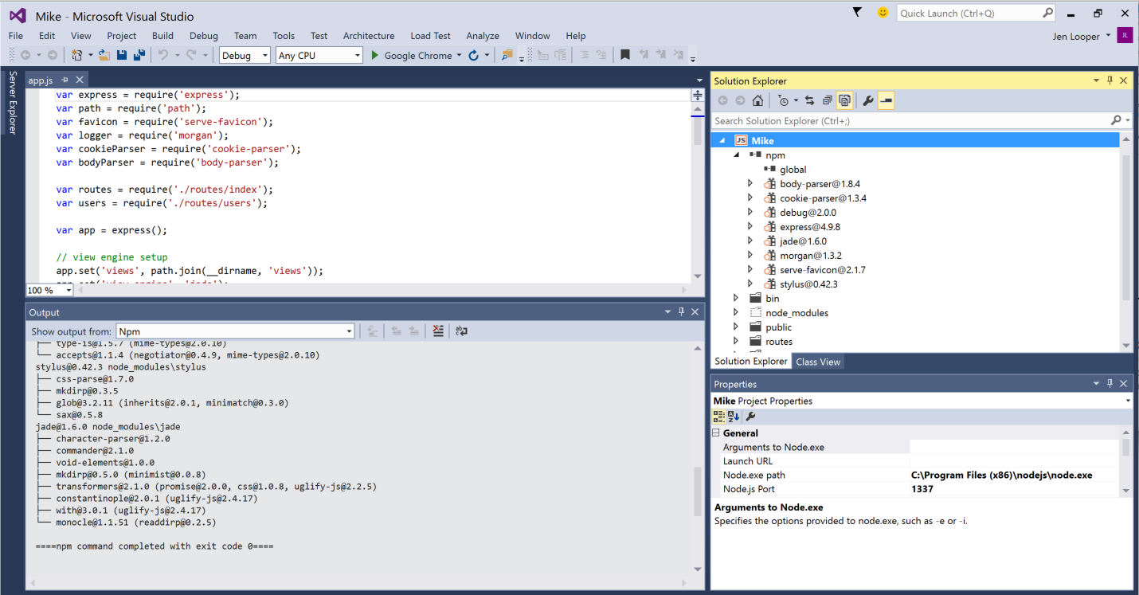
…and scaffold a basic Express app to run on NodeJS

Slide 24
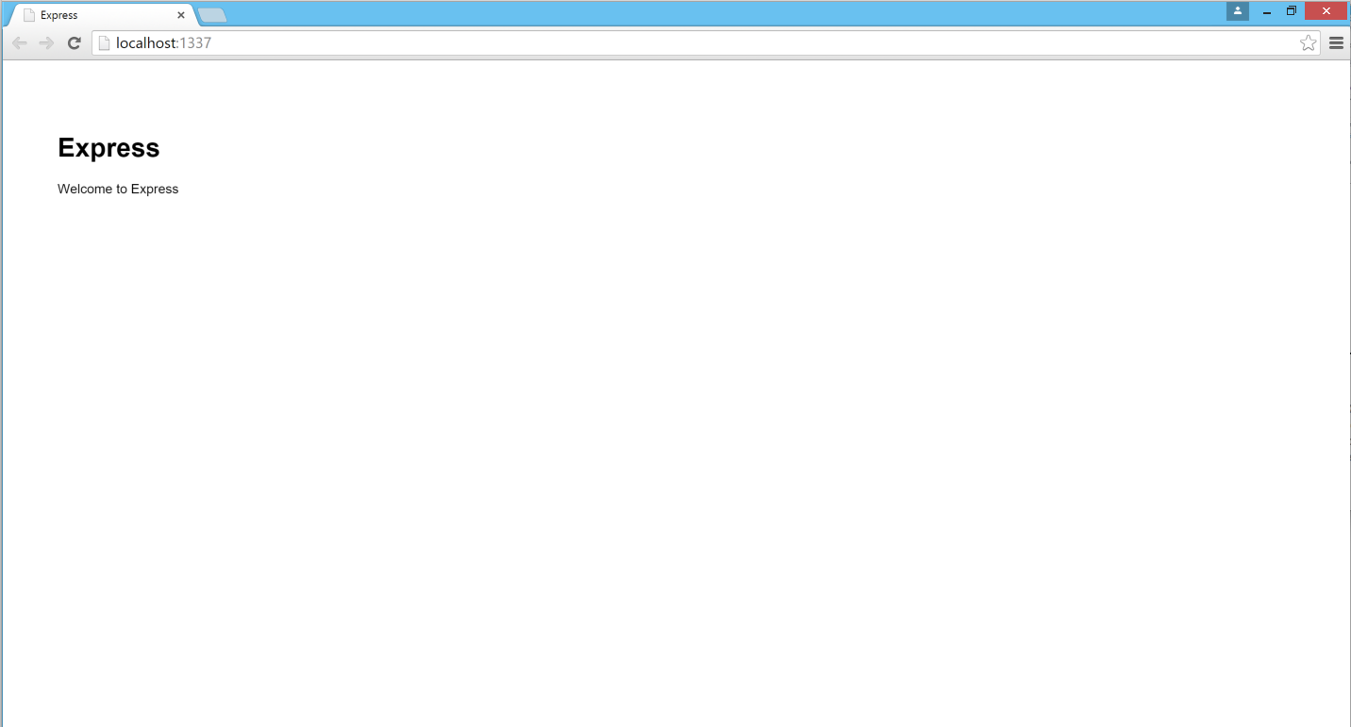
Run the app in Chrome and…

Slide 25
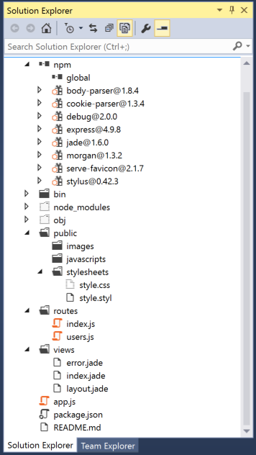
What just happened?
A bunch of dependencies were installed
Public folder > images, CSS, JS
Routes > ‘traffic signals’
Views > jade templates for each view
app.js > base file
package.json > lists dependencies to install

Slide 26
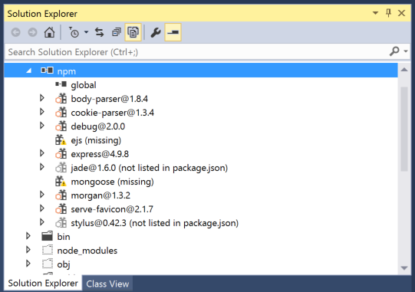
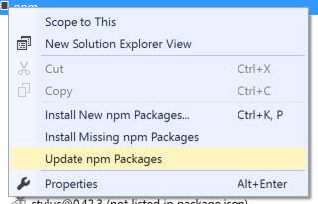
We don’t need a lot of those dependencies. Let’s change it up. Edit package.json and update npm Packages in VS
"dependencies": {
"express": "~4.9.0",
"body-parser": "~1.8.1",
"mongoose": "3.8.11",
"cookie-parser": "~1.3.3",
"morgan": "~1.3.0",
"serve-favicon": "~2.1.3",
"debug": "~2.0.0",
"ejs": "^1.0.0"
}

Slide 27
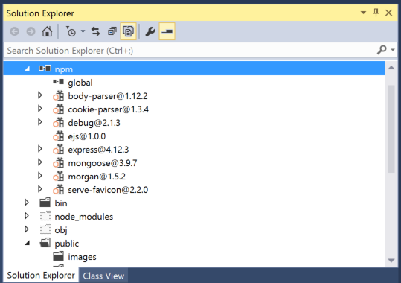

Now we have only packages we need: we got rid of jade* and stylus**
*because “ew”
**because we don’t really need it now

Slide 28
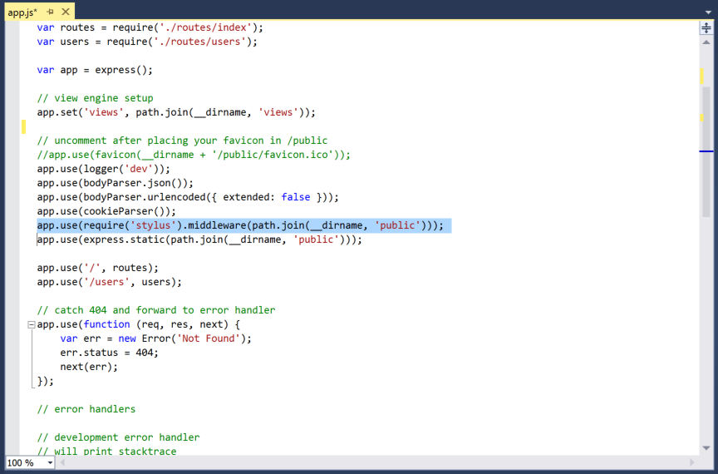
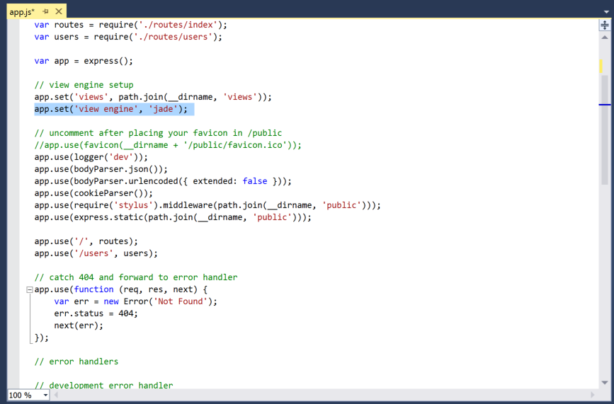
1. Housekeeping – remove reference to jade and stylus in app.js and delete .jade and .styl files
remove

Slide 29
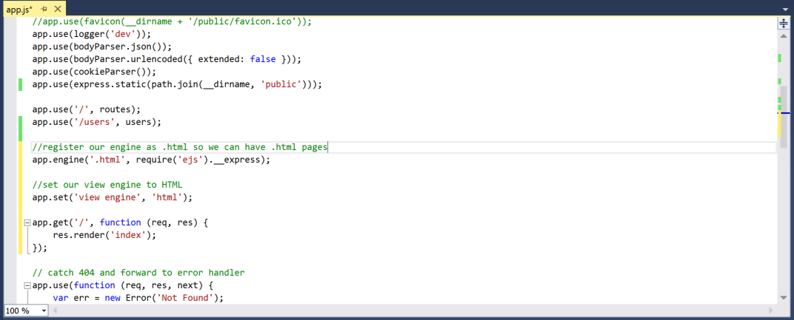
Set our rendering engine to be html, since we don’t use jade

Slide 30
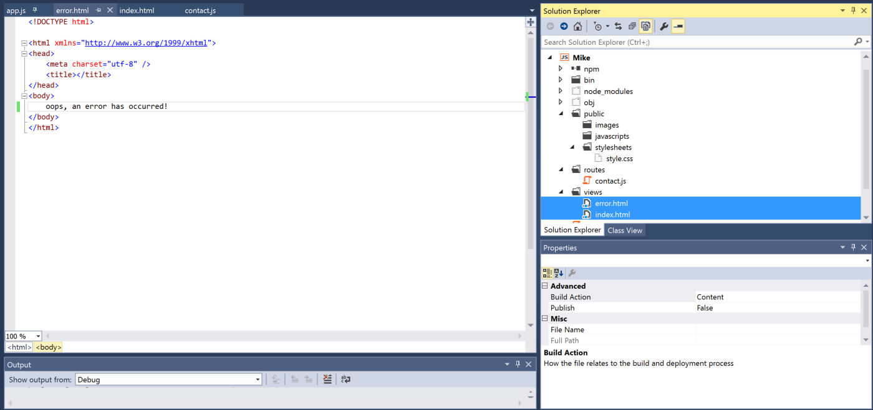
Replace the .jade templates with some simple html (for now)

Slide 31
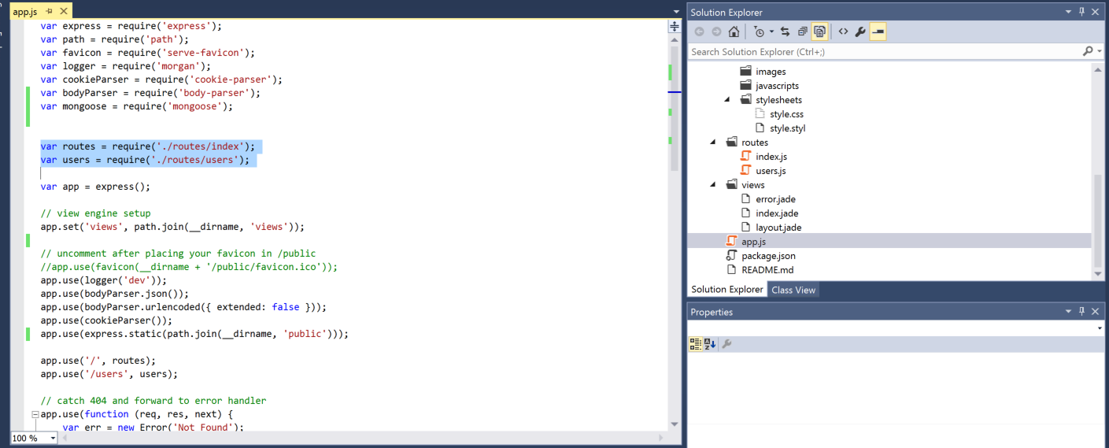
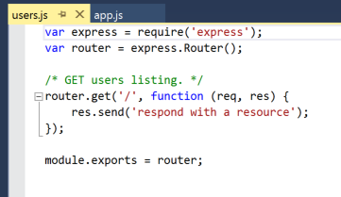
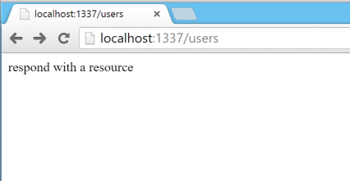
2. Routing. Let’s look at routing in Express
Routes correspond
to web pages and calls:
localhost:1337/users

Slide 32
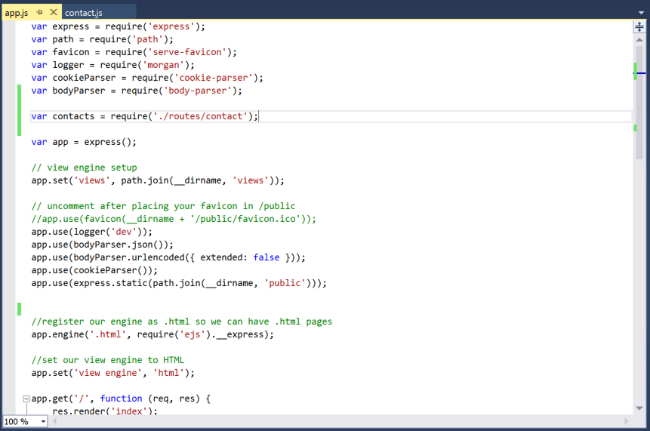
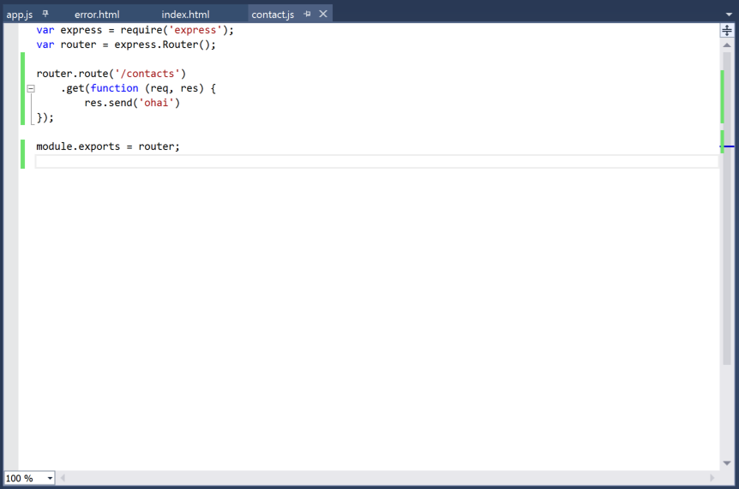
Building our /contact routes
Delete all /routes files, replace with contact.js

Slide 33
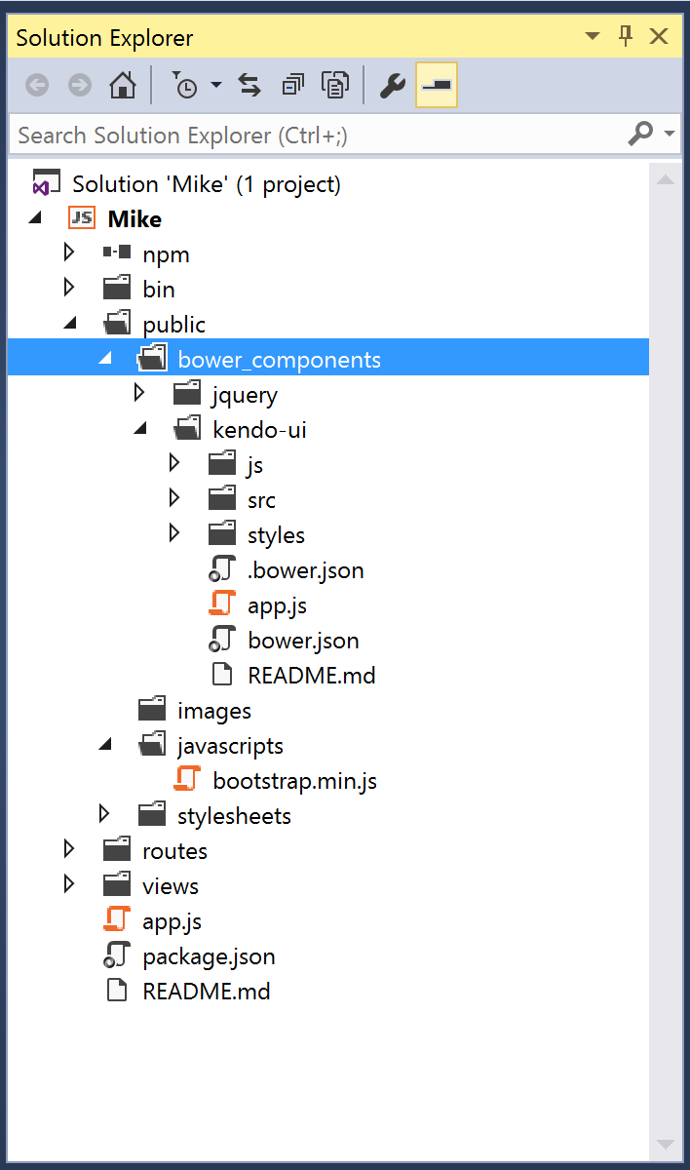
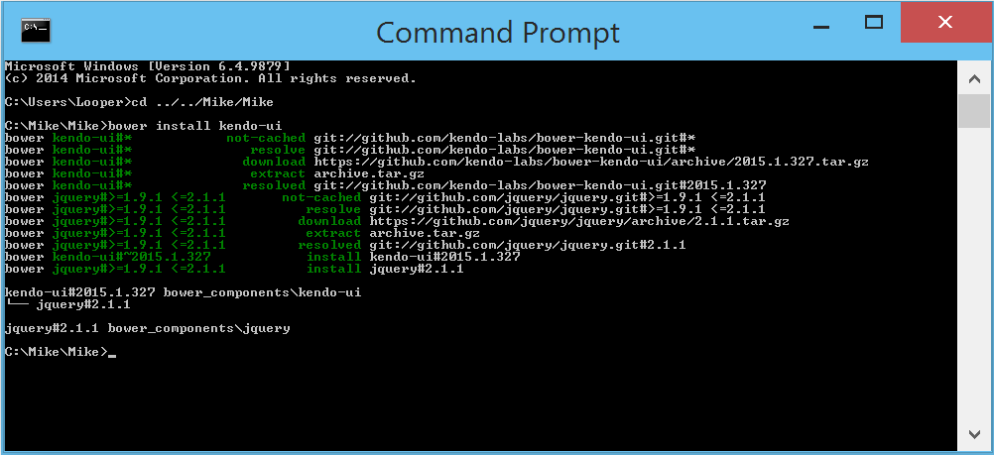
3. Let’s add Kendo UI !
npm install –g bower
make sure you have git installed
bower install kendo-ui
Add to /public

Slide 34
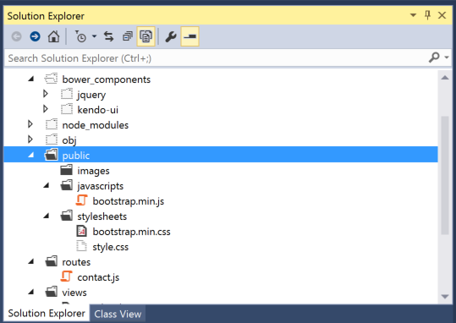
Add bootstrap .js, bootstrap styles, and custom styles
/public/javascripts/bootstrap.min.js
/public/stylesheets/bootstrap.min.css
/public/stylesheets/style.css

Slide 35
Build out Kendo templates in index.html
Link up all the scripts in the header
Add a blank div <div id=“main"></div>
Add 3 kendo templates – nav, home-view, contact-view
<script type="text/x-kendo-template" id="home-view">
<div class="view-content">
<div class="container content">
<div class="row">
<div class="col-sm-12">
Home
</div>
</div>
</div>
</div>
</script>

Slide 36
Add app.js to /bower_components/kendo-ui
/kendo/app.js will turn our Express app into a SPA
_MIKE.startSPA = function () {
_kendoRouter.start();
_baseLayout.render('#main');
}
Use Express for managing database calls via Express routes
Use Kendo for page routing

Slide 37
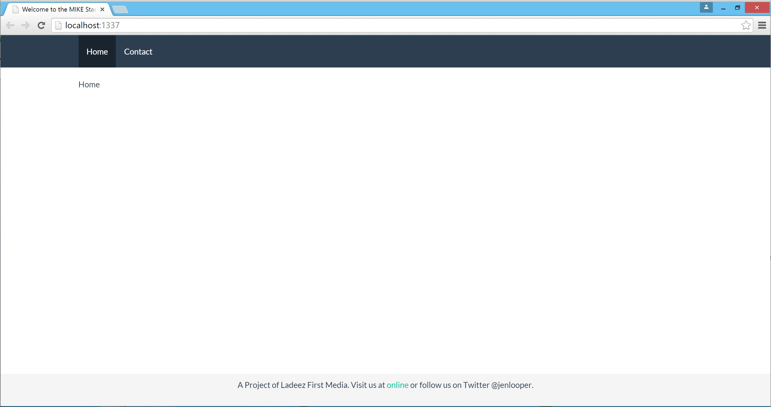
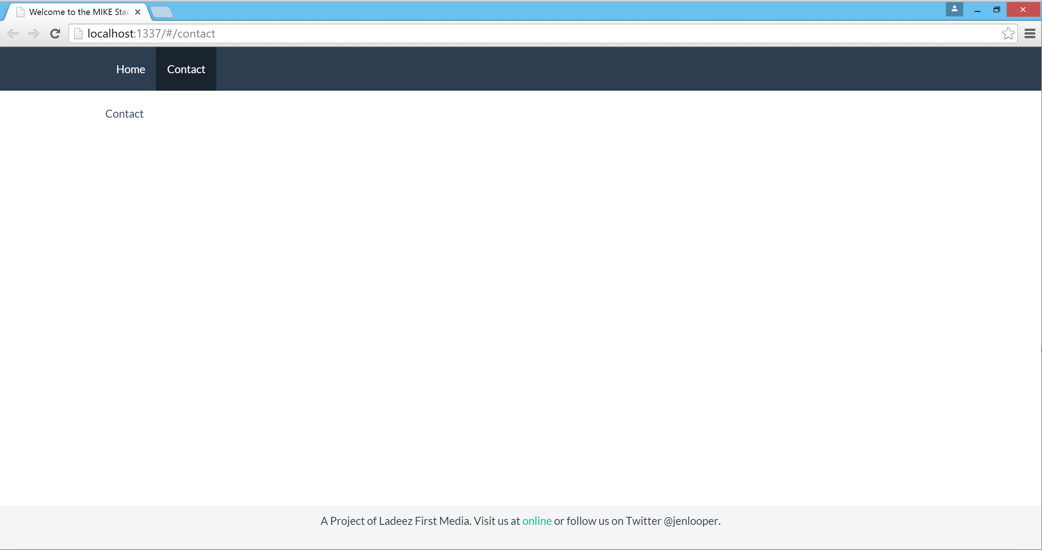
Fire it up!
In index.html, call startApp:
<script>
(function() {
MIKE.startApp();
})();
</script>

Slide 38
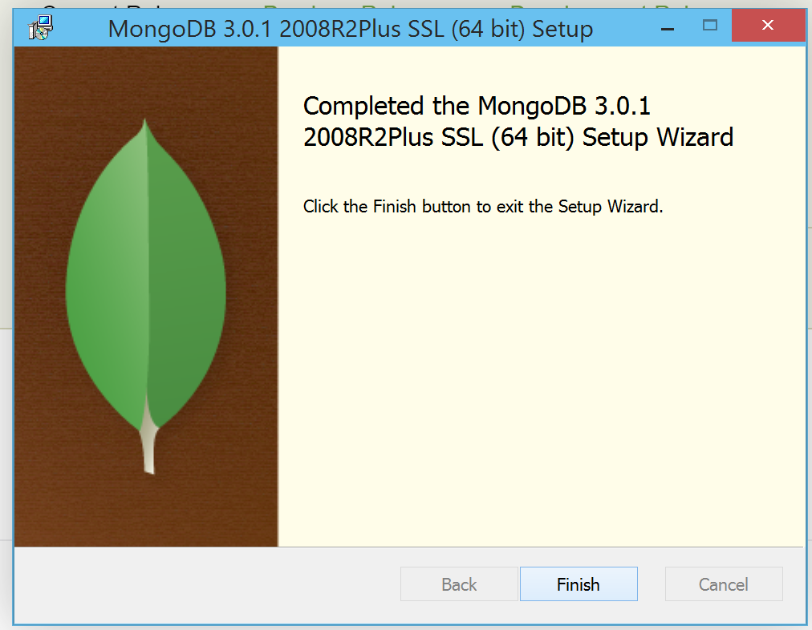
4. All about that database!
Install MongoDB, and start it up with ‘mongod’ and then ‘mongo’

Slide 39
Require mongoose and connect to the local db
In /app.js:
var mongoose = require('mongoose');
var connectionString = 'mongodb://127.0.0.1/contacts'
mongoose.connect(connectionString);
Database name
Mongoose provides structure for MongoDB. You can create a model to whip data into shape.

Slide 40
Make a data schema to shape data sent to MongoDB
Create a new file: /models/contact.js
var mongoose=require('mongoose');
var Schema=mongoose.Schema;
var contactSchema = new Schema({
fName: String,
lName: String,
email: String,
status: String,
schedule: String,
message: String
});
module.exports = mongoose.model('Contact', contactSchema);

Slide 41
Make your data model available to your Express routes
In routes/contact.js, add a line:
var Contact = require(‘../models/contact’);

Slide 42
5. Create your API
In /app.js, add:
app.use('/api', contacts);
…set up ajax call
$.ajax({
url: '/api/contacts',
type: 'post',
data: serializedDataToPost,
contentType: 'application/json'
}).done(function (data) {
$('.alert-success').toggle();
$(".success-message").html(data.message);
}).fail(function (data) {
$('.alert-danger').toggle();
$(".fail-message").html(data.message);
});

Slide 43
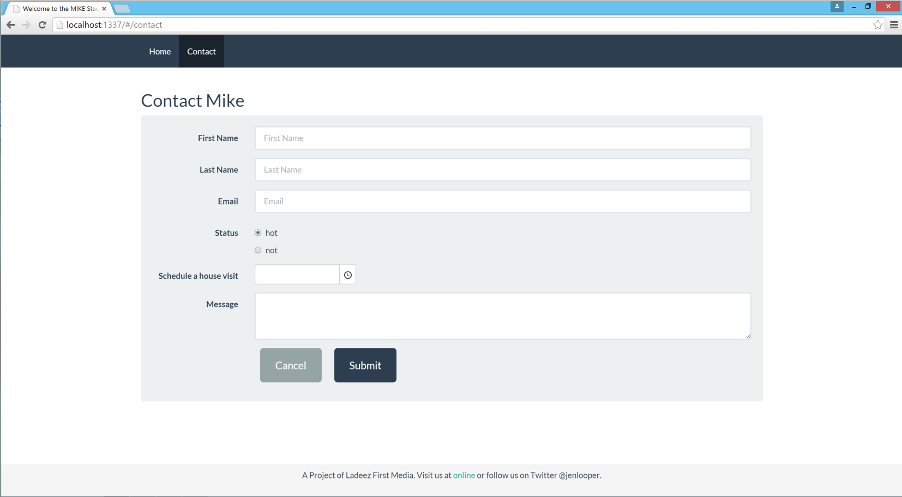
Build a form on the frontend to get contact info

Slide 44
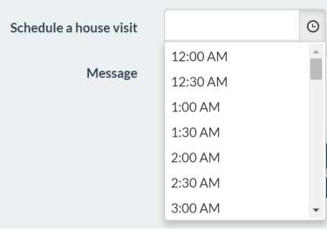
See the pretty widgets! (I spy Kendo UI)
<input id="schedule" name="schedule" data-role="timepicker" data-bind="value: schedule" value="10:00 AM">

Slide 45
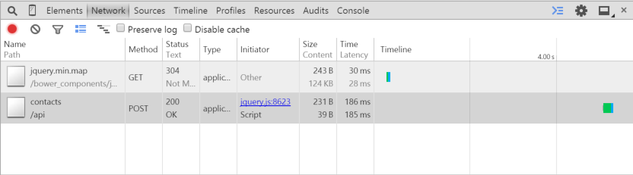
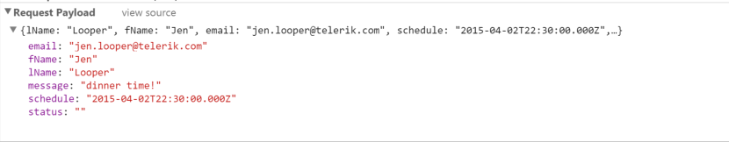
Test the form post
Query mongo to see data
db.contacts.find()
{ "_id" : ObjectId("551d79a387ff1b140eb4f663"), "lName" : "Looper", "fName" : "Jen", "email" : "jen.looper@telerik.com", "schedule" : "2015-04-03T22:30:00.000Z", "status" : "", "message" : ”dinner time!", "__v" : 0 }
>

Slide 46
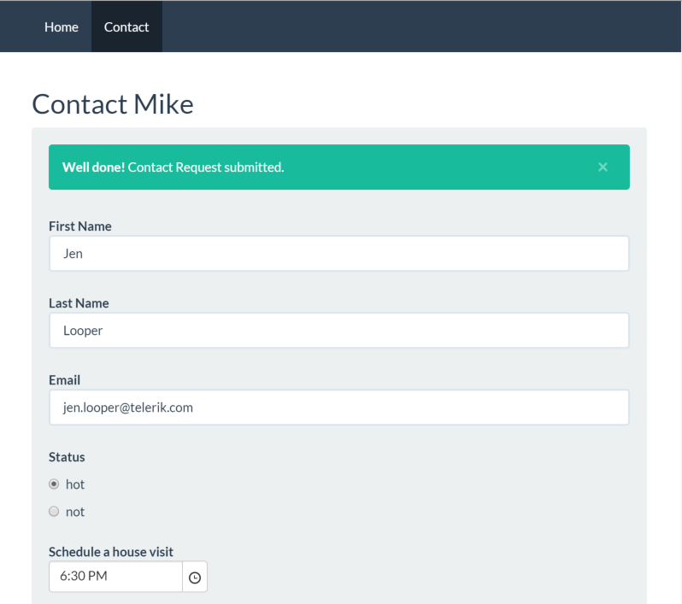
What just happened!?
Frontend form gathered data
Made ajax call via Kendo UI framework
Shaped up the data using Mongoose schema
Via Express route, sent data to Mongo, bubbled up message from Express to Frontend
Scheduled Mike to come to dinner
Dropped mic’ and walked away

Slide 47
Trivia question!!!
For a prize!
What is the name of the company that builds the Node.js add-ons for Visual Studio?

Slide 48
Let’s take Mike to Production!
Charlie Key
Co-Founder, Modulus
@Zwigby

Slide 49
Thank you!
Jen Looper
Developer Advocate, Telerik
@jenlooper
Charlie Key
Co-Founder, Modulus
@Zwigby
Evaluation: http://bit.ly/next-looper-2

